Slide 1
Employee Data Analysis using Excel
STUDENT NAME: SHARMILA DEVI B
REGISTER NO: 2213211042064
DEPARTMENT: B.COM ( Corporate Sectaryship)
COLLEGE: Presidency College, Chennai

Slide 2
EMPLOYEES PERFORMANCE
Employee Performance Analysis using Excel Through Their Performance

Slide 3


AGENDA
Problem Statement
Project Overview
End Users
Our Solution and Proposition
Dataset Description
Modelling Approach
Results and Discussion
Conclusion
3/21/2024 Annual Review

Slide 4

PROBLEM STATEMENT
Employee performance problems may manifest in the form of decreased productivity, difficulty prioritizing tasks, committing errors in projects, or missing deadlines. The obstacles involved in these performance problems are as varied as the employees you have.
Generally, a performance problem is the result of some workload not getting the resources it needs to complete in time. Or the resource is obtained but is not fast enough to provide the desired response time.
For most performance issues, initial steps should include setting/clarifying expectations, coaching and training to help an employee learn and adapt in their role.
Performance problem solving is a purposeful process that shouldn't be confused with Decision Making which is committing to a course of action!
.

Slide 5
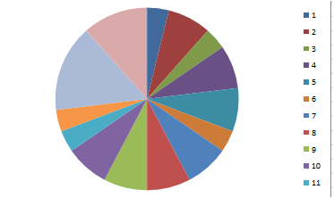

PROJECT OVERVIEW
.

Slide 6

WHO ARE THE END USERS?
An end user is a person or other entity that consumes or makes use of the goods or services produced by businesses. In this way, an end user may differ from a customer since the entity or person that buys a product or service may not be the one who actually uses it.

Slide 7

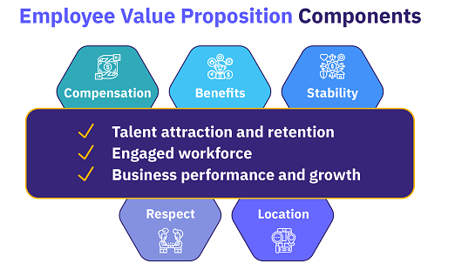
OUR SOLUTION AND ITS VALUE PROPOSITION
An employee value proposition (EVP) can be defined as: a statement of the values, rewards, recognition, support, and company culture that an employer gives employees, enabling them to do their best work and achieve their highest potential.

Slide 8
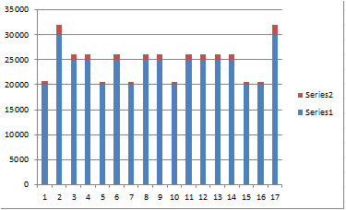
Dataset Description
A data set (or dataset) is a collection of data. In the case of tabular data, a data set corresponds to one or more database tables, where every column of a table represents a particular variable, and each row corresponds to a given record of the data set in question.

Slide 9

THE "WOW" IN OUR SOLUTION
"Wow moments" are unique and memorable experiences during the onboarding process that leave a lasting impression on new hires. These moments typically evoke positive emotions and establish a strong connection between the employee and the organization.
3/21/2024 Annual Review
9

Slide 10
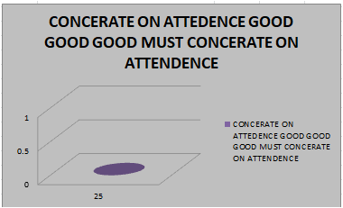
MODELLING
Performance management models are the frameworks that guide how organizations set and align goals, evaluate employee performance, and promote continuous development. Choosing the right model is crucial for boosting employee performance, alignment, employee engagement, productivity, and overall organizational success.
10

Slide 11
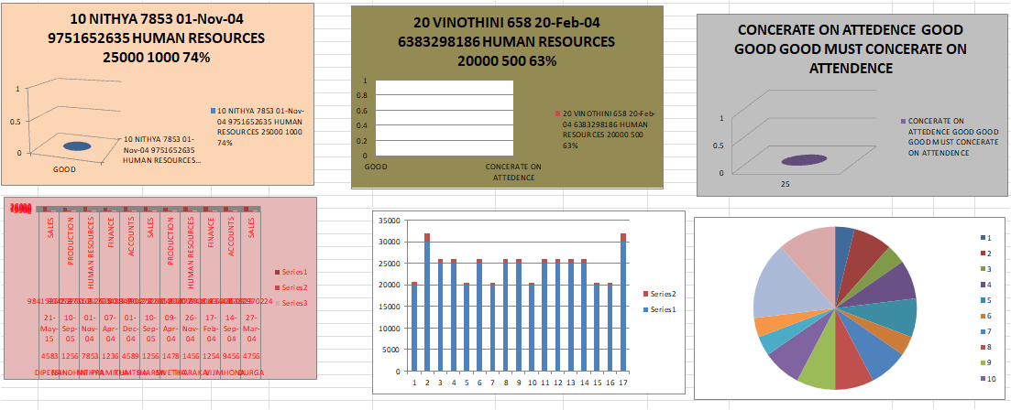
RESULTS
11

Slide 12

conclusion

